Slide 1

Project Name
Project Dashboard Template
March1, 2025
Kailong duan, Anushka Chaudhari, Manuel Garcia
WOW (Every Saturday/5pm,Zoom)
Notes:
September 2010
1

Slide 2



Team Profile Page
Kailong Duan
Henan, China
Project Management
Graduate Student in CS
Worked as software engineer for 3 years.
Anushka Arvind Chaudhari
Project Management
Graduate Student in CS
Participated In Various Technical College events during undergrad
Manuel Garcia
Irving, TX
CS Undergrad Commercial Real Estate Broker for over 4 years
Notes:
Individual Picture of each member
Hometown (city, state)
Primary focus area or desired focus area
Current internship position or job position (company is not needed)
One interesting fun fact about the person

Slide 3
SmartBid Auction Platform
Project Status is Yellow
Criteria to Green resolve resource challenge
Summary Project Status Financial Status
SmartBid Auction Platform is an advanced bidding system designed to optimize online auctions, particularly for businesses and procurement processes. It uses AI-powered automation, real-time analytics, and competitive bidding strategies to enhance efficiency and transparency
Project has started gathering requirements for the stakeholder template after getting the SOW signed. Team is in a good spirit to start the next tasks.
Contract Price: $ 1.5M
Cost (Baselined): $800k
Actual Spend: $ $ 13,440
ETC: $ $535,360.00
EAC: $ $548,800
Current Margin: 63.25%
Key Achievements
Planned Activities
Risks
Major Milestones
•Completed SOW – Mar 3
•Completed documenting stakeholders objectives – Mar 6
•Finalize stakeholder template - Mar 7
•Start gathering frontend requirements - Mar 8
task 36 Create Pictures and Video File Storage System Req might be delayed if technical requirements for storage capacity and security are unclear, which could impact the start of Task 59 Wireframes.
M1: Asses the current storage infrastructure and security protocols to ensure they meet the project’s goals
M2 : Engage storage and security experts early to define clear capacity and security requirements.
•SOW Signed
•Complete requirements specification document - June 19
•Complete coding- July 23
•Code ready for testing- July 24
•Complete Testing -Aug 27
deploy -Aug 29
Notes:
3/4/20252011-10-19
3
CRICKET_HOUSTON_CDMA_LTE_MEETING
3
3
CDMA_LTE_STEERING_MEETING
2012-06-13

Slide 4
Governance Plan Overview
The governance plan for the Smart Bid Auction project is designed to encourage close collaboration between the Technical leadership Team and Stakeholders, which ensures technical progress is closely tied with user needs and risk management. Stakeholders will actively contribute by giving feedback on functionality and user experience by meeting with Leads on regular basis. The senior leadership stakeholders will participate in key recurring meetings to ensure the project stays aligned with strategic goals and approve major decisions.
➔What are the challenges?
While this plan involves a balanced approach between technical details and Stakeholders feedback and strategic oversight, potential challenges such as coordinating feedback from different groups without delaying development could arise. Additionally, getting busy senior leaders to adhere to regular meeting schedules may also be difficult.

Slide 5
Governance Plan Table
Governance Type | Day / Time | Purpose | Input | Output | Attendees (Owner)
Weekly Internal Status Meeting | M/W 9am-10am | Review Schedule, RAID, Resources, Financials | MPP, RAID, CR Log, Current Status, Previous Dashboard | Updated MPP, RAID, CR Log, and Dashboard | (PM) Team Leads, Technical Managers
Weekly External Client Status Meeting | Friday 11:00am-11:30am | Review progress, RAID, gather feedback | Updated dashboard, RAID, Handle feedback and customer requests. | update Client feedback, | (PM) Client, Project Team Leads
Weekly Internal Technical Meeting | Thursday 11:00am-11:30am | Discuss and solve technical issues | Technical updates and bug issue feedback. | Technical upgrades and bug fixes. | Team Leads Arch Leads, Req Leads
Weekly Internal Manager/Director Status Meeting | Thursday 3:00 am-4:30am | Review progress, RAID,Determine resource allocation issues. | Customer feedback and resource issues. | Determine resource allocation and provide feedback to the customer. | (PM) VPs, managers CFO,,COO,CTO
Monthly Internal department meeting | Friday 10:00am-11:00am | Coordinate departmental communication and handle legal and financial issues. | Resource delivery involved in the project, legal and financial risks. | Updated RAID | (PM) VPs, managers CFO,CTO,COO,Chief Legal Officer

Slide 6
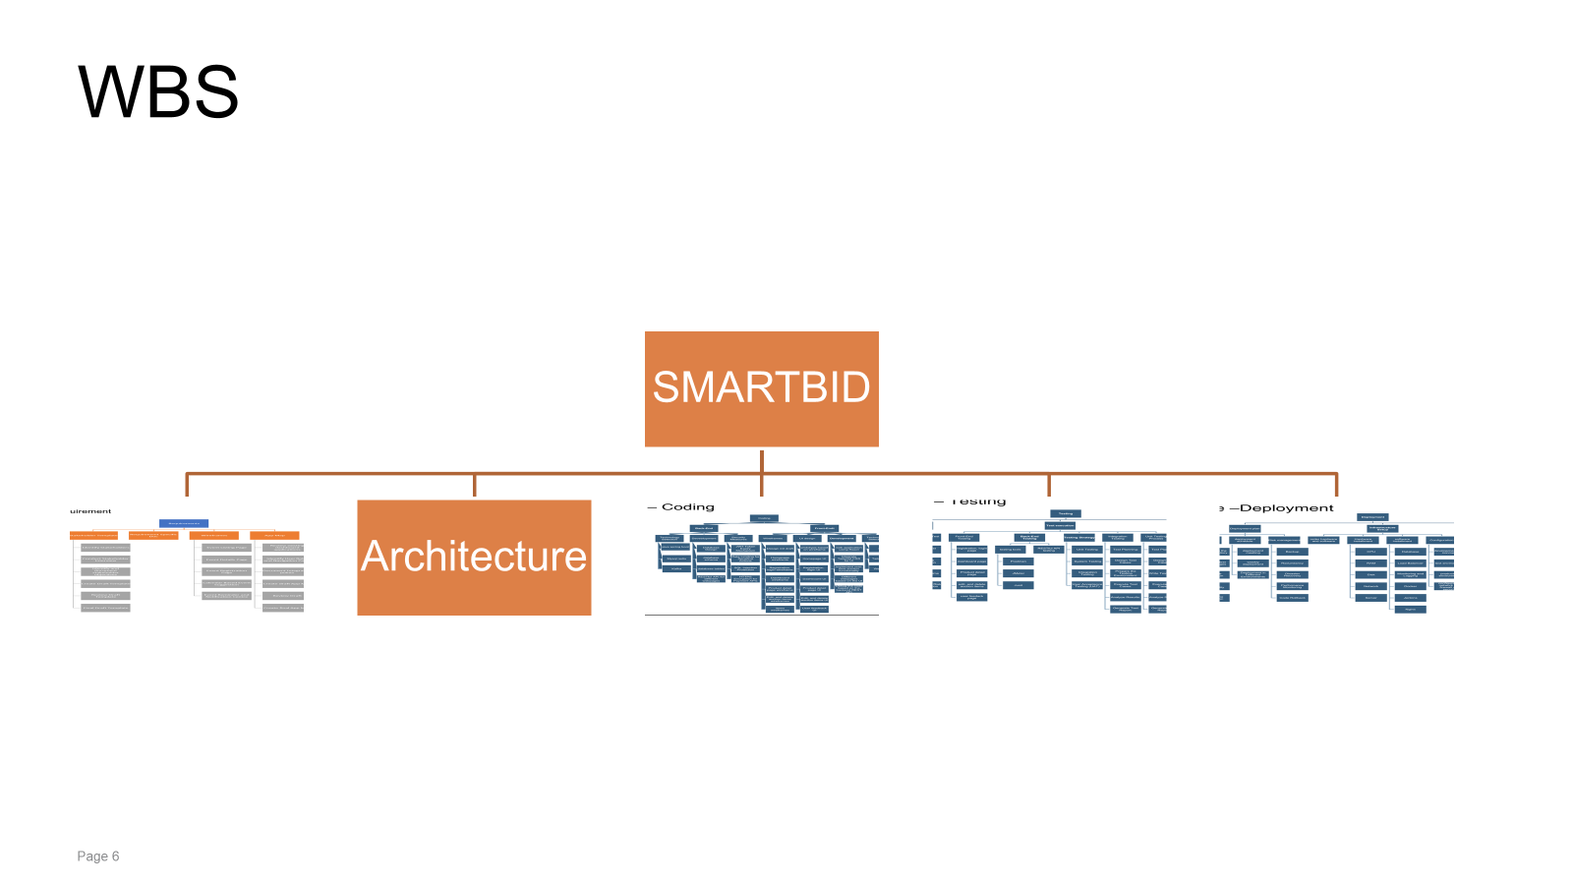
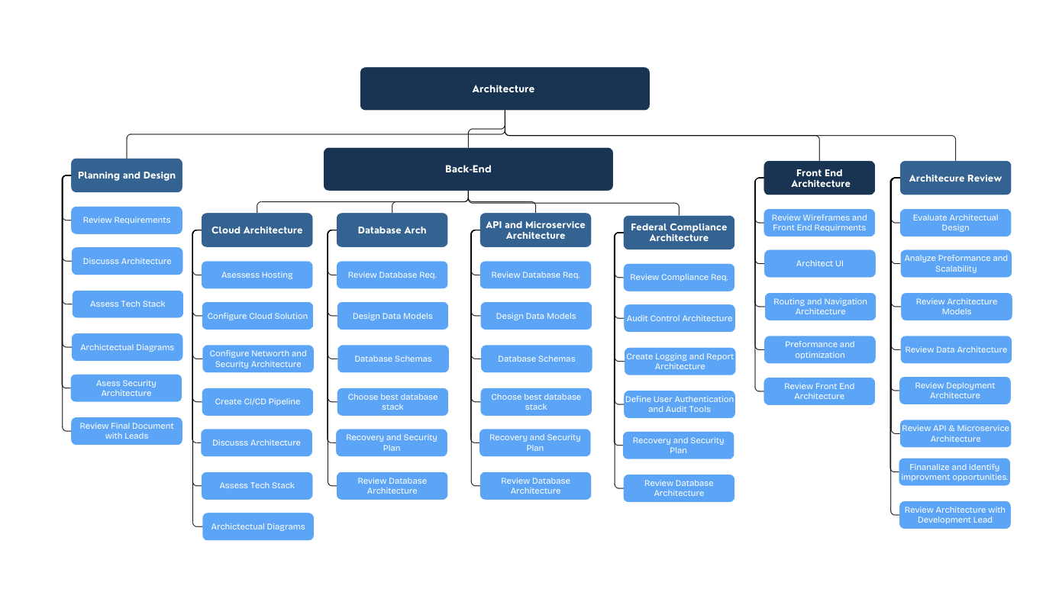

Slide 7
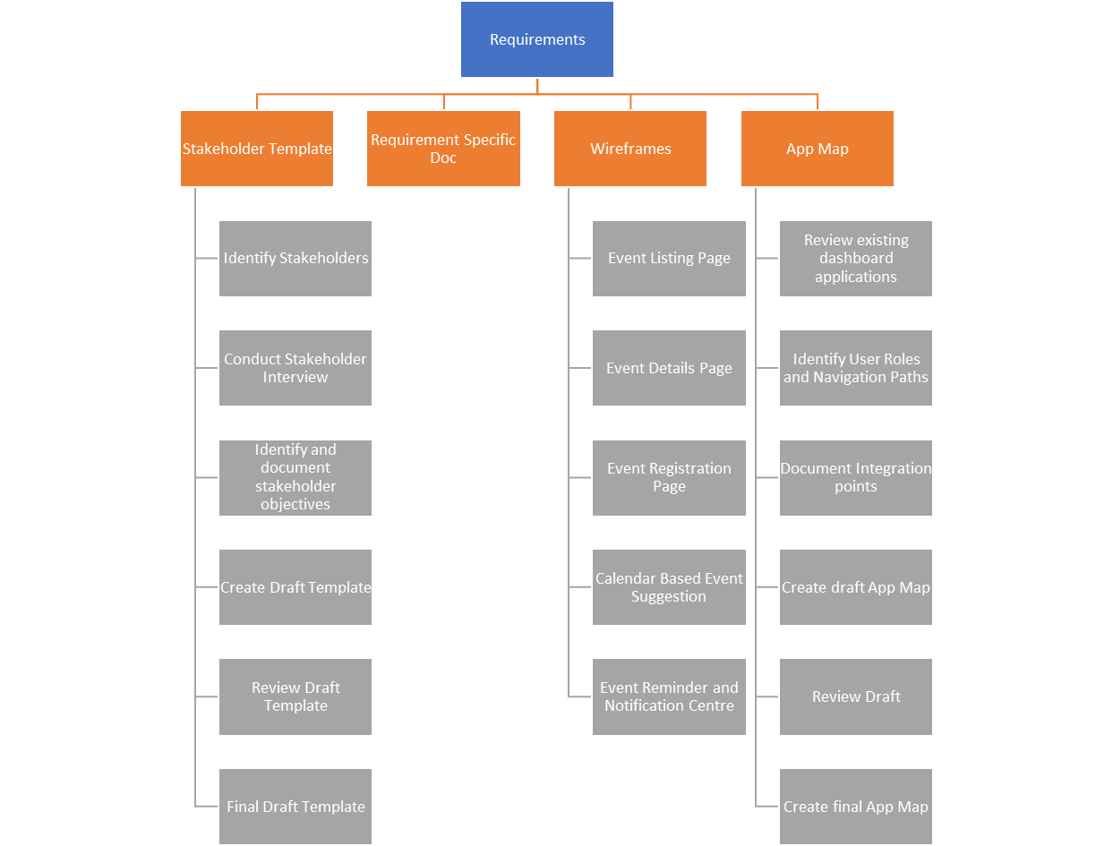
WBS Requirement

Slide 8
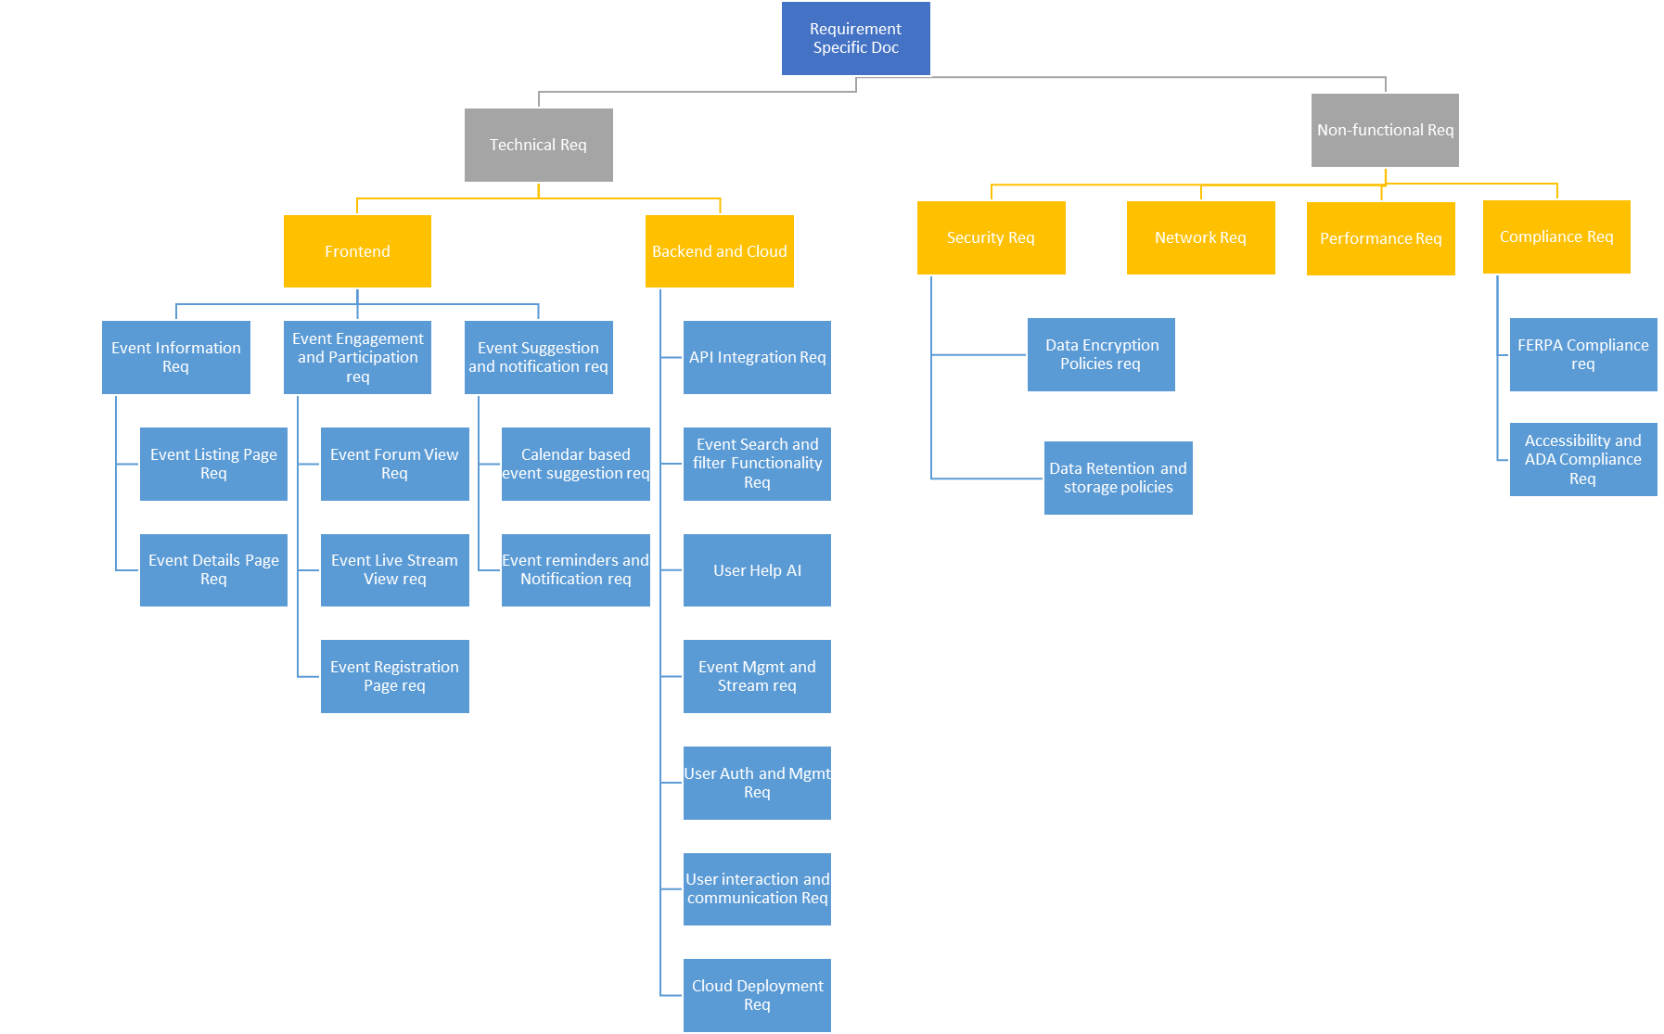
WBS REQUIREMENT

Slide 9
WBS Architecture

Slide 10
WBS Slide – Coding-Updated
Coding
Back-End
database design
User, Medical Supplies schema
Medical Supplies, schema
Develop CRUD operations
Security Measures
Front-End
Rating & Reviews, schema
Real-Time Bidding System
Automatic Price Update
email notification
Payment
Add support for various credit card payments
Add PayPal support.
Payment Gateway Integration
payment Confirmation
Payment History
Payment Status Tracking
UI design
Rating & Reviews UI
User Authentication UI
User Profiles UI
Admin Dashboard UI
Edit, and delete auction items UI
User feedback UI
Development
User Profiles
User Login, Register,
Review / Verification
Medical Supplies Auction Settings
Detailed Description
Function List
Image Upload
Price Settings
Auction Time Settings
Payment
redit/Debit Card,
Digital Wallets, paypal
Feedback
Comment
Rating
Customer Support & Complaint Resolution
Dispute Resolution
Admin Dashboard
User Account Mang
Medical Supplies Approval
Generate Medical Supplies Quality
Transaction Report
Transaction Approval
Auction Status Tracking
Proxy Bidding
auction item management
Real-Time Bidding Data
Historical Bidding Records
AI-based Bidding Algorithms
Model selection
Data collection
Data preprocessing
Reinforcement learning
Objective function
Optimize the bidding strategy
Model evaluation
Anti-Cheating System
Rate Limiting
IP and Device Tracking
Behavioral Analysis
Blacklist and User Restrictions
Manual Review System

Slide 11
WBS Slide – Testing-updated
Testing
Test planning
UAT testing
Front-end Testing
User Authentication
registration, login
Payment testing
Feedback
Back-end Testing
User Management Service
Medical Supplies Online Service.
Feedback and Rating Service.
Medical Supplies Product Review and Verification Service.
Real-Time Bidding System Service.
API Integration
other Testing.
Security Testing.
Performance Testing.
Scalability Testing.
Usability Testing.
Test execution
UAT testing
prepare UAT evnironment
define testing scenarios
get feedback from UAT team
sign off and documents
Integration Testing
prepare testing evnironment
add testing Cases
Front-end page Testing
Back-end API Testing
Performance Testing
Test reporting and defect tracking
bug logging
Search for Bug Logs
Classify Bug Logs
Organize Bug Report
Send to Developers for Handling
Bug tracking
Add Bug Report Progress Tracking
Display Report After Handling, Further Testing
Bug Issue Resolution Completed
Determine Test Objects
Define Test Scope
Resource Preparation
Schedule Time
identification Risk and mitigation
AI-based Bidding Algorth Testing
Define experimental
Monitoring indicators:
Add Main indicators
auction success rate
Deploying new algorithms
data analysis
Algorithm update
Test process
Continuous monitoring
Iterative optimization

Slide 12
WBS Slide –Deployment-uploaded
Infrastructure Setup
Deployment
deployment target/ requirement
deployment schedule
weekly deployment
Risk management
Backup
Connect to the code repository
Pull the latest code changes
Build the application
Verify functionality
Deploy the application
deployment meeting
Deployment in Different Environments
Redundancy
Disaster Recovery
Performance Monitoring
Code Rollback
Deployment plan
order hardware and software
Hardware installment
CPU
RAM
Disk
Network
Server
software installment
Database
Load Balancer
Monitoring and Logging
Docker
Jenkins
Nginx
Configuration
development environment
test environment
production environment
configure the network and firewall and security
deployment Solution
deployment tools
Jenkins
Kubernetes
Helm
product released
release process
release management
Validate Feedback collection
gather and analysis
AI-based Bidding Deploy
Model Export
Inference Service
Monitoring & Optimization
Version Control
Continuous Updates (CI/CD)

Slide 13
Cost Comparison Slide Requirements
Top-Down Cost
$169,200.00
Bottom-up Cost
$871,040.00
What changed in the Bottom-Up Estimate ?
High total effort and extended duration: The BU factors In real durations that extend beyond what was estimated for the TU. For example in TU, backend requirements was estimated to take 10 days where as in the BU is it estimated to take 56 days which is more than double. Because of the extended duration and more efforts from resources the cost for the BU is high.
More resources utilized: The BU estimate includes more Requirement Engineers(7) working in parallel or together sometimes depending on the tasks. The BU has more time-intensive tasks than the TU and allocates more time to do requirements review.
Detailed task breakdown: The BU estimate comes from a more granular breakdown of tasks. Instead of just high-level categories, each task is broken down into more detailed requirement gathering and reviews tasks. Because of the breakdown of tasks, the BU reflects the true work involved.
What is real for the BU ?
The BU involves Stakeholder Template, Wireframes and App Map Requirements gathering that will add more time when compared to the TU.
The BU estimates 88 days for Technical requirements gathering which is more than double of what TU estimates(19 days)
The BU total days comes up to be 102 days which is significantly bigger than the original TU estimate which is 29 days.
The cost differences between the Top-Down (TD) estimate, which was set at $169,200,
shows a significant underestimation when compared to the Bottom-Up (BU) estimate
, which amounts to $871,040.
Assumption for the Top-Down Estimate
Simplified Resource utilization assumption The TD estimate assumes that two Requirements
Engineers working with a Requirement Lead suffices for the project. In addition the TD allocates
less time to review requirements and focuses more on gathering requirements.
Simplified task breakdown: The TD estimate focused on major categories(Tech Stack, Frontend
, Backend) without taking accounting for the granularity of the actual tasks required under
each category.

Slide 14
Cost Comparison Slide - Architecture
Top-Down Cost
$120,000
Bottom-up Cost
$243,000.00
Variance
What were some of the big changes. Duration, hourly cost, etc
Roles not accounted for
Regulations we need to adhere to given we are making software for a medical company
Additional requirements
The cost differences between the Top-Down (TD) estimate, which was set at $169,200,
shows a significant underestimation when compared to the Bottom-Up (BU) estimate
, which amounts to $243,000.000
Assumption for the Top-Down Estimate
Simplified Resource utilization assumption The TD estimate assumes that 2 architecture engineers. a lead and a PM. We did not consider the cloud solutions, database intricacies, and overall sheer volume of work required. When broken down into steps and researched further we discovered various agencies which have requirements of their own for medical software.
Simplified task breakdown: The TD estimate focused on major categories(Tech Stack, Frontend
, Backend) without taking accounting for the granularity of the actual tasks required under
each category.

Slide 15
Cost Comparison Slide Summary
Top-Down Cost
Req : $169,200.00
Arch : $120,000
Code $30,000.00
Test: $10,000.00
Deploy:$20,000.00
PM : $63,200.00
Total Cost: $349,200.00
Margin: $69,840.00
Price $419,040.00
Bottom-up Cost
Req: $871,040.00
Arch : $243,000
Code: $49,800.00
Test: $13,120.00
Deploy:$13,000.00
PM : $316,800.00
Total Cost: $1,189,960.00
Margin: $237,992.000
Price: $1,427,952.00
Variance
Our Bottom-Up (BU) cost comes out to be $1,264,387, which is a 63% increase when compared to the Top-Down (TU) cost. The price difference between BU and TU shows a significant underestimation of resources and duration in the TU estimation. Major cost differences were observed across all project phases, with coding costs rising by 147%, testing costs increasing by $103,027, and project management costs nearly tripling to $316,800.The duration for each phase has doubled or more than doubled.Each phase has increased resources by 15%.Many review tasks (PM tasks) were included in BU, which were not part of TU estimation.More comprehensive testing phases were needed, leading to increased time and cost.Higher complexity in architecture design led to greater effort estimates.

Slide 16
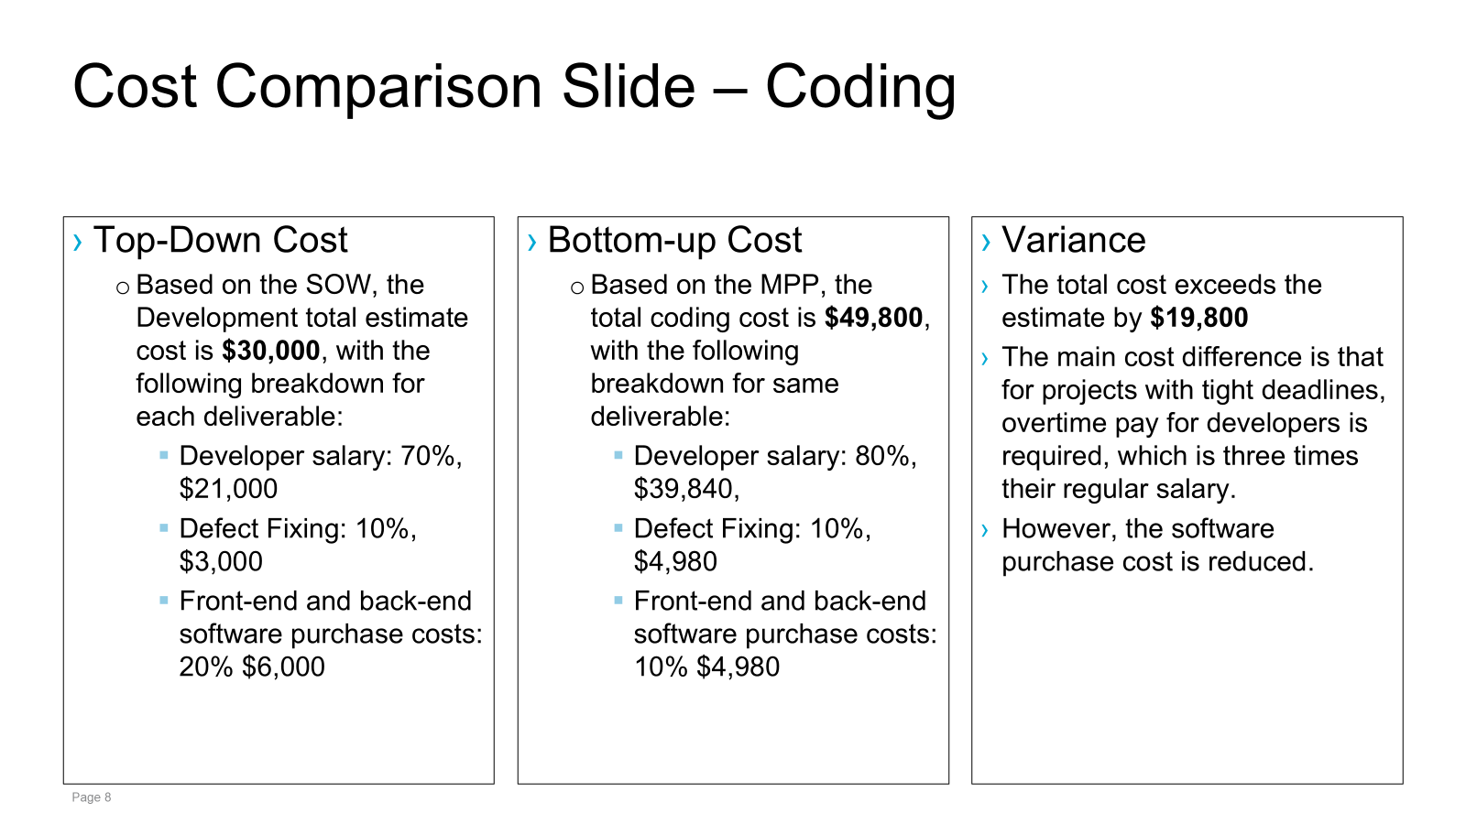

Slide 17
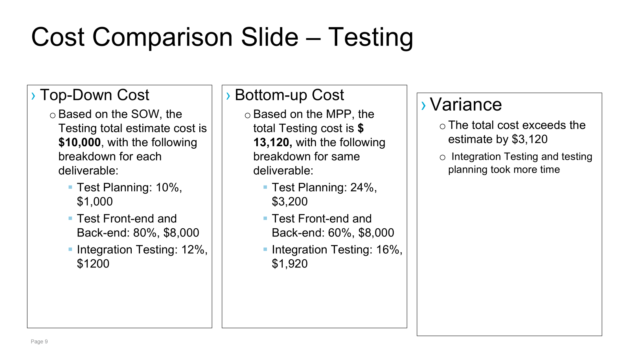

Slide 18
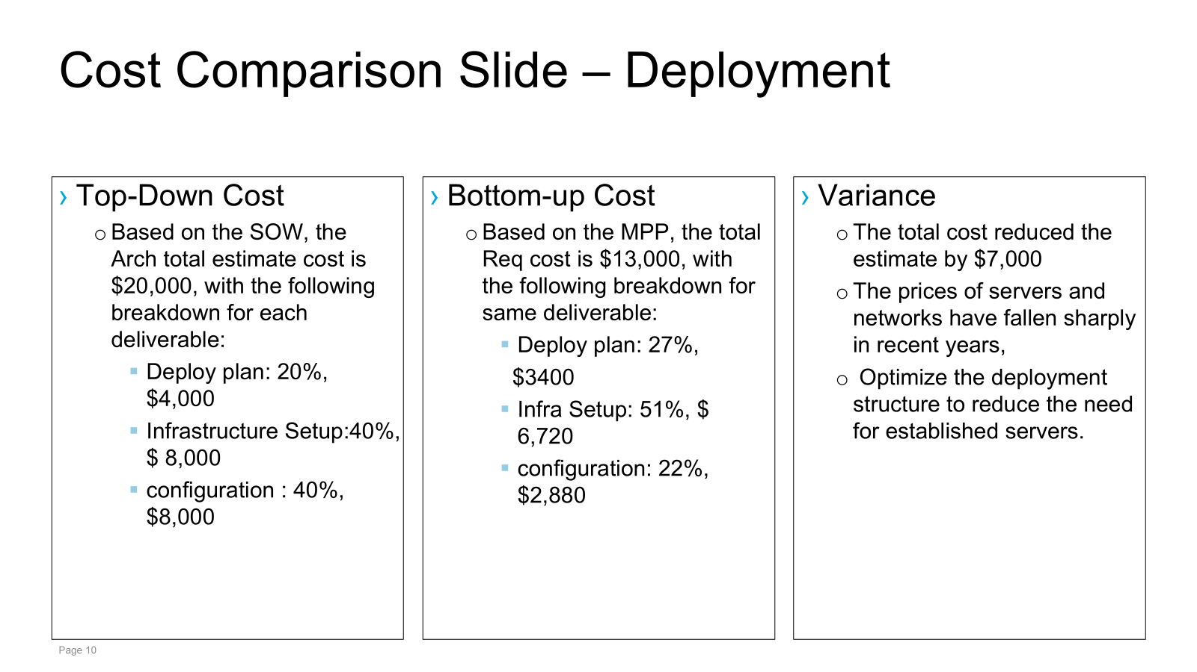

Slide 19
Project Key Risks
# | Risk | Mitigation | Contingency | Owner | Due Date | Comments
R1 | Task 36 Create Pictures and Video File Storage System Req might be delayed if technical requirements for storage capacity and security are unclear, which could impact the start of Task 59 Wireframes. | Asses the current storage infrastructure and security protocols to ensure they meet the project’s goals. | Use an interim cloud storage solution to store and access files until the final system is ready | Anushka | April 15 | The primary risk stems from unclear technical requirements , which can impact subsequent tasks like task 59 wireframes
R2 | Task 18 Gather Event Information Req might be delayed if stakeholders do not provide complete event details on time, which could impact the start of Task 25 Backend Req. | Communicate the importance of timely submission of event details to stakeholders and set clear deadlines for them. Ensure they understand how their delay affects the overall timeline. | Establish a firm deadline for stakeholder responses and send automated reminders and follow up with stakeholders individually to ensure accountability | Anushka | March 29 | This is a common issue in projects requiring external input , making proactive engagement crucial

Slide 20
Project Key Risks - Architecture
# | Risk | Mitigation | Contingency | Owner | Due Date | Comments
R3 | Task 110 Creating The Architecture For Federal Compliance: HIPPA, FDA, PHI. Agencies may require much more intricate solutions | Ensure all engineers on the project are well informed and provided with detailed specifics of what is required by agencies | Create Architecture ahead of schedule to allow ample time for review. | Manny | Oct 7 | Adhering to agencies will always have its intricacies and challenges.
R4 | Task 104 Creating API architecture. Vendors may require that API’s to access our service adhere to their standard which may significantly vary from company to company. | Communicate the importance of reviewing all requirements. Every Architecture section has a dedicated review date to ensure no requirements are forgotten nor looked over | Have Arch leads review the API’s and assess that all requirements are made before delivering to the development team. | Manny | Nov 4 | Given multiple vendors will use our platform we need to ensure their data and ours is accessible via well engineered API with all the proper security features and functionality.

Slide 21
Project Key Risks-Coding-updated
# | Risk | Mitigation | Contingency | Owner | Due Date | Comments
R5. | Task 102 - ​Complex Authentication System: Implementing secure user authentication with proper verification processes may take longer than anticipated. It includes Identification, Credential Verification, Access Control, Session Management, etc. The code complexity is relatively high, which may lead to delays. | M1:Use ​pre-built auth solutions (Firebase Auth, Auth0) to speed up development. M2: Implement ​modular verification steps (email → phone → document upload). | 1. If verification takes too long, ​launch with basic email auth first and add advanced verification in Phase2 2.Assign more developers to participate in this project. | Kailong duan | June25
R6. | Task 99-When users upload high-resolution images of medical supplies, they often experience painfully slow upload speeds that get stuck halfway. If multiple users upload images simultaneously, it can easily overwhelm the server. Add unstable mobile connections into the mix, and you get frequent upload failures halfway through - it seriously ruins the user experience. | M1:We'll use AWS S3 with CloudFront CDN to turbocharge image delivery. medical supply photos get stored in Amazon's secure cloud. CloudFront automatically distributes them to servers worldwide. Users always download from the nearest location M2: Built-in image optimization (auto-format conversion, sizing). Scales instantly during traffic spikes | 1.If uploads fail, provide ​manual upload via email as a temporary workaround. 2. can call customer service to help customers upload pictures | Kailong duan | July 2

Slide 22
Project Key Risks- Testing-updated
# | Risk | Mitigation | Contingency | Owner | Due Date | Comments
R7 | Task175-we need define auction testing scenarios. There may not be enough defined scenarios and insufficient coverage. | M1:​ Develop and provide code coverage reports (≥80% required),Include as many test scenarios and test cases as possible M2: Use AI to generate supplementary test cases (such as Postman Automation), normalize and scale to include almost all test scenarios. | 1. Implement gradual feature rollout (canary release) with real-user behavior monitoring for post-launch testing and add it to the testing environment. 2. ​ Ensure that most test scenarios can be tested if time is insufficient. | Kailong duan | Sep 11
R8 | Task 179- The test environment is unstable or crashes due to environment configuration errors or data contamination. | M1: Add containerized test environment with advanced environment configuration technology (Docker+K8s one-click reset) M2: Add the automatic rollback function. Add triggers automatic rollback immediately after an environment crash (based on previous day's environment backup) | 1. Allow direct testing of pre-production environments during emergency repair 2. Provide local testing sandbox to developers for emergency use. | Kailong duan | Sep 11

Slide 23
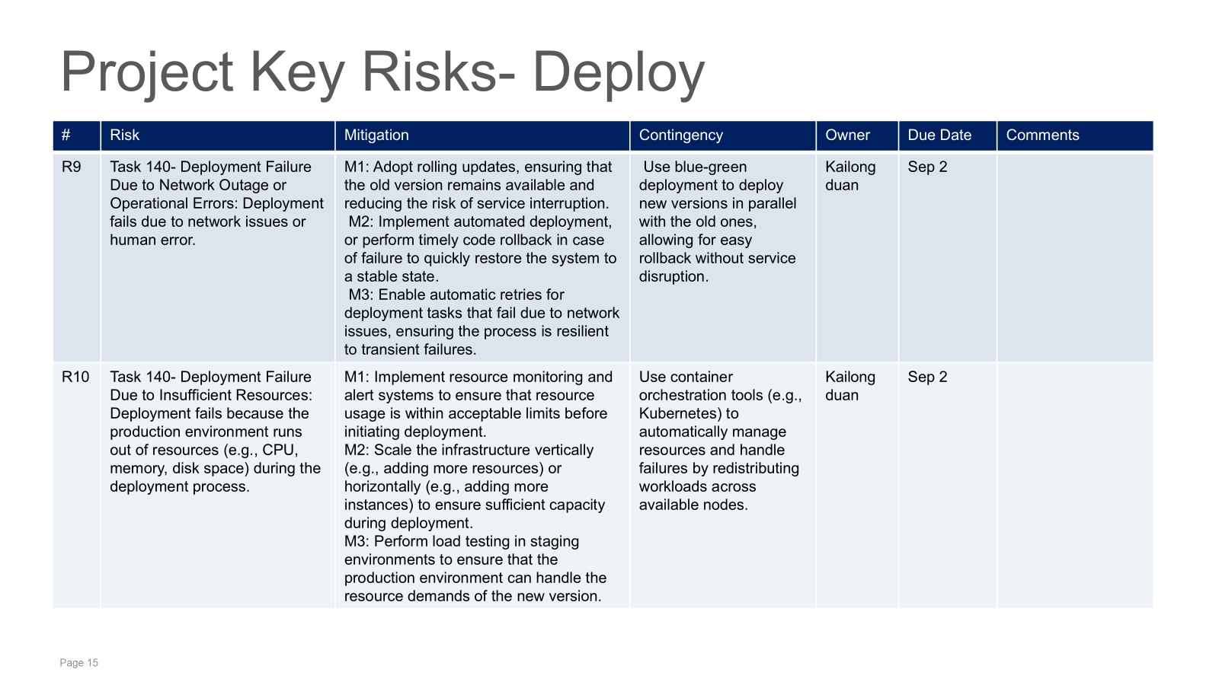

Slide 24
Project Key Actions
# | Description | Originator (Student Name) | Owner | Date Assigned | Date Needed | Date Closed | Comments
A1 | Define Required Event Information and share with stakeholder | Anushka | Requirement Lead | April 15 | April 17 |  | Collect detail event information and ensure timely sharing with stakeholders to align expectations and next steps.
A2 | Identify Storage and Security Requirements | Anushka | Requirement Lead | March 29 | April 13 |  | Ensure early alignment with security compliance guidelines
K1 | Invite customers and relevant stakeholders to multiple Zoom or phone meetings to clarify requirements as quickly as possible. | kailong duan | PM | June 25 | June 20 |  | related to R5
K2 | Add various testing methods, including boundary testing, functional testing, and SQL injection prevention. | kailong duan | Testing Lead | Sep 11 | Sep 13 |  | related to R7
M1 | Identify compliance requirements which involve altering our architecture | Manny Garcia | Arch Lead | Sep 28th | Oct 5th
M1 | Define database requirements regarding a Sql/NoSQl | Manny Garcia | Arch Lead | Oct 9th | Oct 15

Slide 25
Project Decisions
# | Description | Owner (Student Name) | Decision Date | Comments
D-1 | Approved that project would fund to a hire a third-party vendor specialized in legacy database data extraction and integrations to assist with manual data extraction. | Anushka | Mar 9 | Decision was made in the meeting steering with the Technical lead on Mar 9
D-2 | Approve an increase in the number of test personnel recruitment, as the additional testing requirements exceed the original staffing capacity. | kailong duan | Aug 22 | Agreed upon during Technical Meeting on April 1th . Attendees were CTO, VP, PM,CFO,COO, PM, Testing Lead.
D-3 | Approve the purchase of sufficient CPUs, hard drives, servers, or the rental of AWS services. | kailong duan | Aug 28 | Agreed upon during Technical Meeting on April 5th . Attendees were CEO, CFO, COO, VPs, PM,
D-4 | Approve an increase in resources for architecture build out. This included Cloud Engineers, DevOps, and Additional Arch Lead | Manny Garcia | Sep 1 | Agreed upon by PM, CTO, and CFO via online meeting.

Slide 26
Stakeholder Table
Stakeholder | Role | Team | Value
Developers & IT Teams | Director of IT | Customer IT | Provides leadership to customer IT team for project engagement and delivery.
Customer Support & Dispute Resolution Team | Director of Development | Client Delivery Team | Provides leadership to development team on technology, resource, and project engagement
Marketing & Sales Teams | Head of Marketing | Marketing team | Collect feedback from different users and develop a smart website promotion strategy
Auditors & Financial Analysts | Operations Manager | Operations team | Coordinate different customers, buyers and sellers, update and feedback their needs to the development department in a timely manner. Ensure smooth integration of the website and operational workflow.
Logistics & Delivery Partners | Logistics Manager | Logistics team | Ensures timely and efficient delivery of auctioned items. Manages shipping, tracking, and delivery operations.
Compliance & Legal Team | Vice President for Legal Affairs. | Compliance and legal team | Ensure that the SMARTBID complies with legal and regulatory requirements, including data privacy laws
Buyers (Bidders) | End Users | General Users | Participate in auctions to purchase items. Provide feedback and influence platform improvements.
Sellers | Auctioneers & Vendors | Seller Network | List and sell items through the auction platform. Provide product details and ensure smooth transactions..

Slide 27
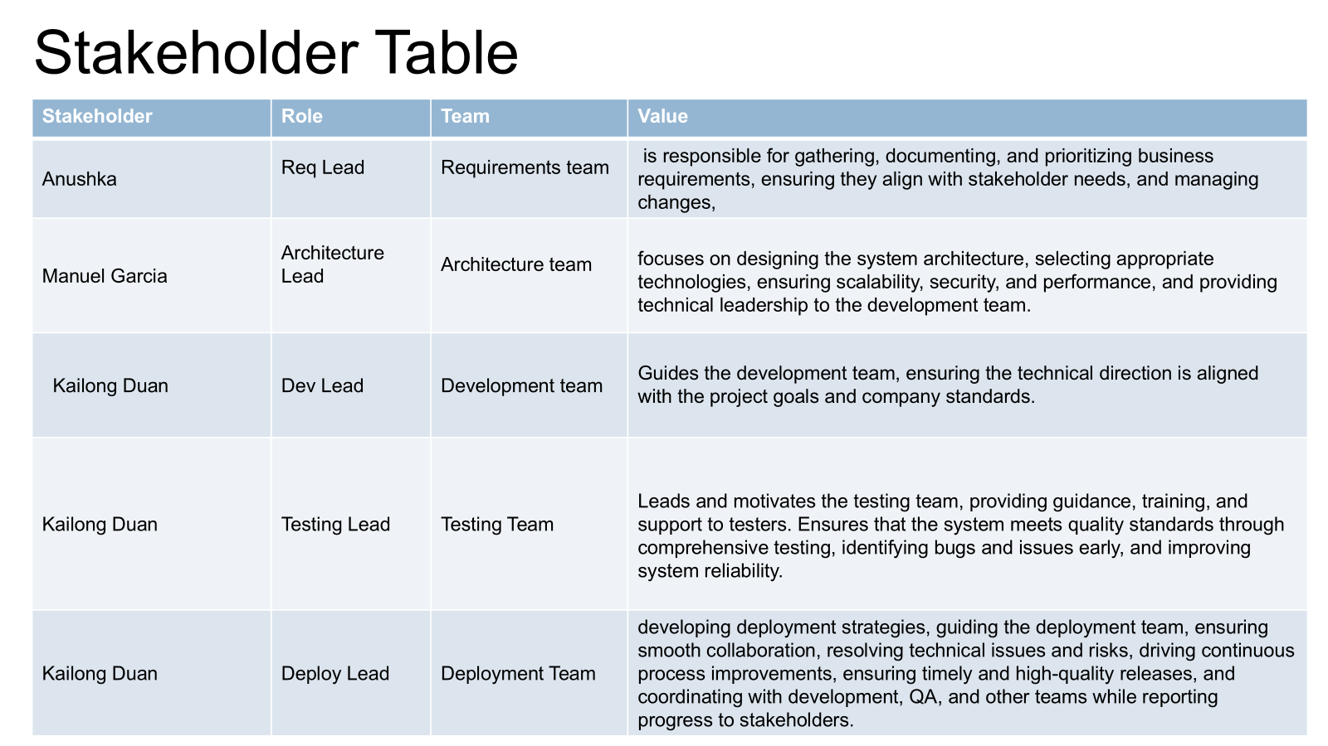

Slide 28
Meeting Minutes (Assignment 2)
Group Number: 10 |  | Project Name: Library Book Sorting
Project Manager (s): Annie R.
Meeting Date | Attendees | Absent | Topic Discussed / Work Assigned
Mar 1 | Manuel Garcia Anushka Chaudhari Kailong Duan | None | Roles discussed again : as req[Anushka],Archi[Manny],Kailong[Coding,testing,deploy] WBS Discussion Project 2 overview
Mar8 | Manuel Garcia Anushka Chaudhari Kailong Duan | None | WBS REQ Done Scheduled Discuss Risks Mitigations Discussed
Mar 9 | Manuel Garcia Anushka Chaudhari Kailong Duan | None | Organize project format Action Planned Discussed Governance Plan discussed

Slide 29
Previous Meeting Slides

Slide 30
Group Number: 2 |  | Project Name: SMARTBID ’s Auction Platform
Project Manager (s): Anushka,Kailong Duan, Manny Garcia
Meeting Date | Attendees | Absent | Topic Discussed / Work Assigned
04-Feb | KailongDuan, Anushka,Manny Garcia | None | We identified the objectives of the assignment and discussed the division of the project, Manny Garcia: Deployment & Architectural Design Kailong Duan: Requirements Engineering & Testing Anushka: Program Management & Implementation/Coding
08-Feb | KailongDuan, Anushka,Manny Garcia | None | Modified the format of the project to clarify the consumer. Start making PPT
10-Feb | KailongDuan, Anushka, | Manny Garcia | Completed the production of ppt, calculated the cost requirements, determined stakeholders and so on
11-Feb | KailongDuan, Anushka, Manny Garcia | None | Complete the project and prepare it for submission.

Slide 31
Previous Assignment Slides

Slide 32
Project Idea Brainstorming
Kailong Duan
AI Meeting Comparison
AI meeting assistant for real-time transcription, summaries, and task tracking.
Campus Social & Event Hub
A social platform for university students to connect and explore campus events.
Anushka Arvind Chaudhari
AI Powered Personal Finance Assistant
AI-powered tool for spending analysis, budgeting, and financial advice.
Online Auction Platform : Smartbid
An online auction website.
Manny Garcia
Mckesson Contract Software
A software used to bid out medical contracts ensuring the cheapest cost
Tesla Rideshare
An uber competitor taking advantage of FSD in states where legal providings

Slide 33
Statement of Work Summary
Project Summary – A web-based SAAS software to facilitate bidding, financial analysis, and logistics of medical products.
Business Value: Lower contract cost saves hospitals money on overhead.
Intended Audience: McKesson and it’s affiliate medical supply connections.
Why This Solution? With ever changing regulations and tariffs cost of medical good ebb and flow. In conjunction with increasing medical cost in the U.S. we deemed this project to have real world applications.
Components & Key Features:
User registration & authentication
Live bidding functionality
Secure payment integration
Seller dashboard for item listings
Logistics/Shipping Dashboard
Admin panel for monitoring transactions
Financial Analysis tool

Slide 34
Cost / Price / Rationale
Cost Overview
Development costs : $100,000
Infrastructure & Hosting: $200,000
Security & Compliance:$50,000
UI/UX & Design: $50,000
Project Management : $50,000
Marketing & Operations:$50,000
Total Cost to Deliver: $500,000
Margin (25%): $125,000
Total Price to Customer: $600,000
The total cost is estimated based on key components required to build and deploy the online auction platform. This includes software development, infrastructure setup, security measures, UI/UX design, project management, and ongoing marketing and operational expenses. A 25% margin is added to ensure profitability and sustainability of the business model.

